Slide 1
Pathway analysis
Ensemble

Slide 2
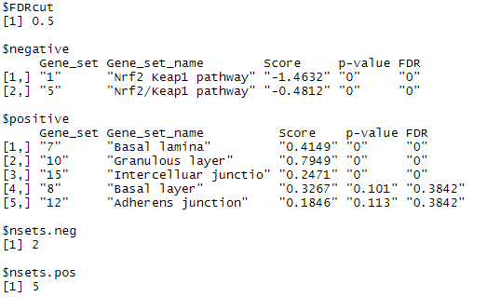
P10 (sample 1 & 2) – our collections

Slide 3
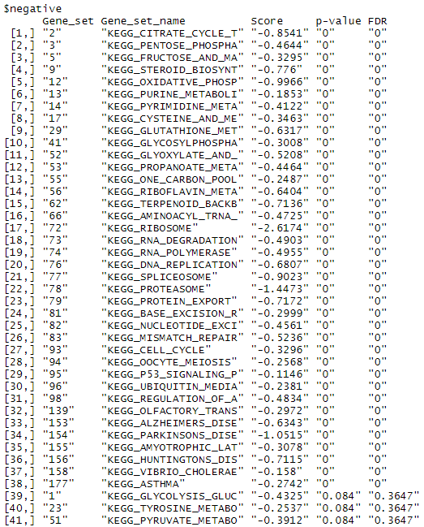
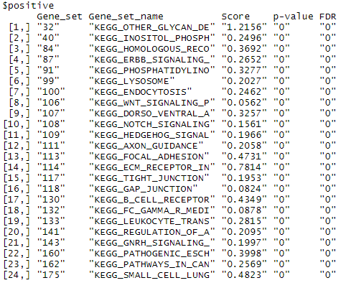
P10 (sample 1 & 2) -- KEGG (v.7)

Slide 4
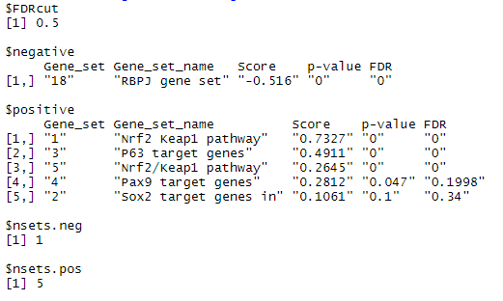
MD ( 3 samples vs. control) – our collections

Slide 5
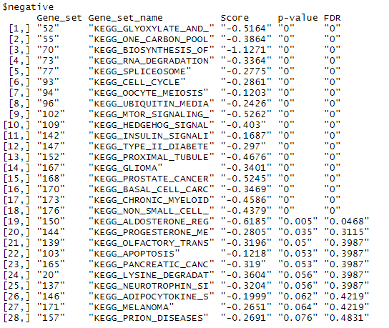
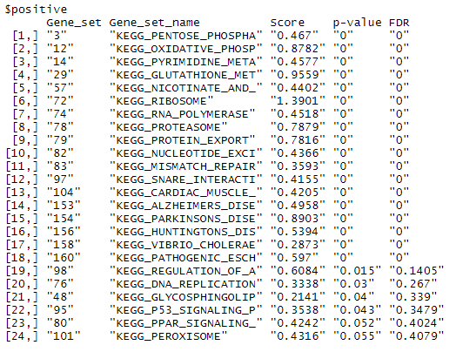
MD ( 3 samples vs. control) -- KEGG (v.7)

Slide 6
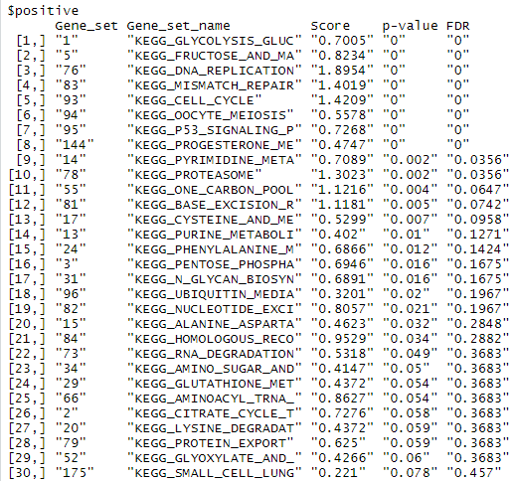
GSE18842 -- KEGG (v.7)

Slide 7
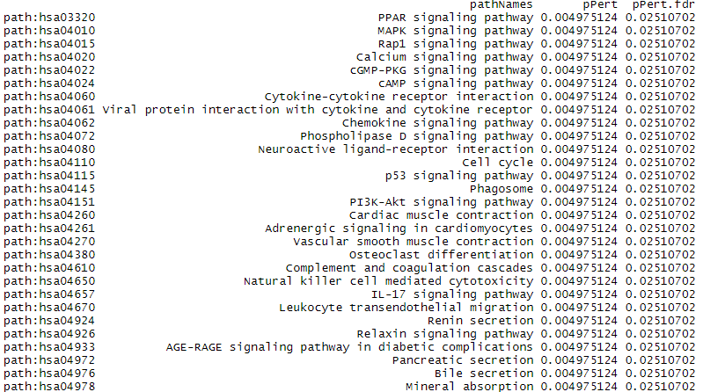
GSE18842 -- KEGG (v.7) -- ROntoTools

Slide 8
NCLC

Slide 9
SCLC

Slide 10
Rap1

